Slide 1
18ECC203J – Module 3 8086 Interfacing with Memory and Programmable Devices S – 6, 7, 8
Prepared by,
Dr. R. Prithiviraj
Dr. Diwakar R. Marur

Slide 2
S – 6 Stepper Motor interfacing

Slide 3

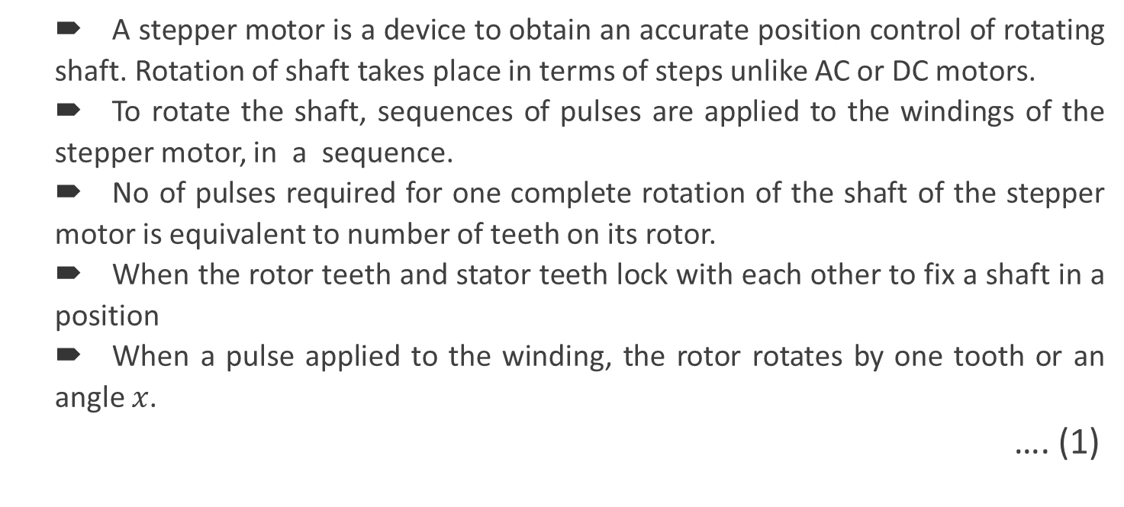
Stepper Motor Interfacing
A stepper motor is a device to obtain an accurate position control of rotating shaft. Rotation of shaft takes place in terms of steps unlike AC or DC motors.
To rotate the shaft, sequences of pulses are applied to the windings of the stepper motor, in a sequence.
No of pulses required for one complete rotation of the shaft of the stepper motor is equivalent to number of teeth on its rotor.
When the rotor teeth and stator teeth lock with each other to fix a shaft in a position
When a pulse applied to the winding, the rotor rotates by one tooth or an angle $x$.
…. (1)
$$x= \frac{{360}^{°}}{no. of rotor teeth}$$

Slide 4
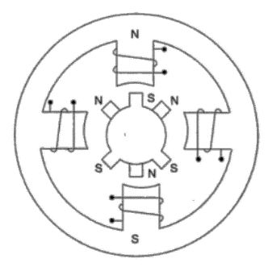
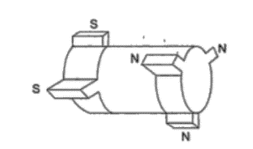
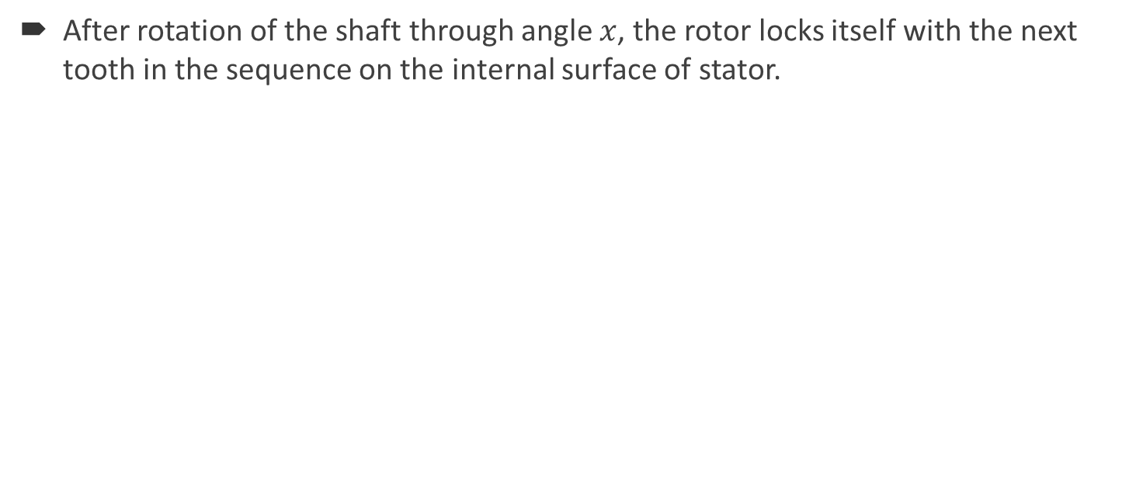
Stepper Motor Interfacing (2)
After rotation of the shaft through angle $x$, the rotor locks itself with the next tooth in the sequence on the internal surface of stator.
Schematic of a stepper motor rotor with six teeth on its surface
Internal Schematic of a four winding Stepper motor

Slide 5
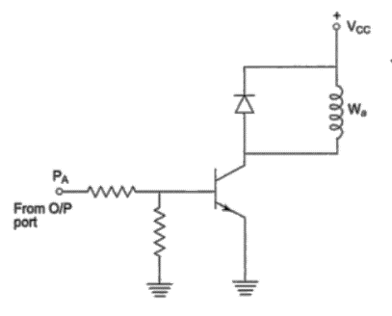
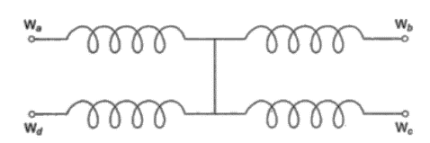
Winding Information
Stepper motors are designed to work with digital circuits. Binary level pulses (0-5 V) are applied to energize the windings.
Winding arrangement of stepper motor
Image Courtesy: Adv. µP by A.K. Ray
Interfacing Stepper Motor Winding W_{a}
Image Courtesy: Adv. µP by A.K. Ray

Slide 6
Types of Schemes
Pulse sequence is decided by the required motion of the shaft.
Types of schemes
Wave Scheme
Full Step Scheme
Half Step Scheme
Wave Scheme
A simple scheme to rotate the shaft of stepper motor.
Here W_{a}, W_{b}, W_{c}, and W_{d} are applied with the required voltage pulses, in cyclic fashion. To change the rotation in opposite direction give pulse sequence in reverse direction.
Full Step Scheme
Here consecutive two windings are excited at a time. These are shifted only one position at a time.
Half Step Scheme
Combination of Wave and Full Step scheme. Used for step angle reduction.

Slide 7
Table 1: Wave Winding
Motion | Step | A | B | C | D
Clockwise | 1 | 1 | 0 | 0 | 0
 | 2 | 0 | 1 | 0 | 0
 | 3 | 0 | 0 | 1 | 0
 | 4 | 0 | 0 | 0 | 1
 | 5 | 1 | 0 | 0 | 0
Anticlockwise | 1 | 1 | 0 | 0 | 0
 | 2 | 0 | 0 | 0 | 1
 | 3 | 0 | 0 | 1 | 0
 | 4 | 0 | 1 | 0 | 0
 | 5 | 1 | 0 | 0 | 0

Slide 8
Table 2: Full Step Winding
Motion | Step | A | B | C | D
Clockwise | 1 | 0 | 0 | 1 | 1
 | 2 | 0 | 1 | 1 | 0
 | 3 | 1 | 1 | 0 | 0
 | 4 | 1 | 0 | 0 | 1
 | 5 | 0 | 0 | 1 | 1
Anticlockwise | 1 | 0 | 0 | 1 | 1
 | 2 | 1 | 0 | 0 | 1
 | 3 | 1 | 1 | 0 | 0
 | 4 | 0 | 1 | 1 | 0
 | 5 | 0 | 0 | 1 | 1

Slide 9
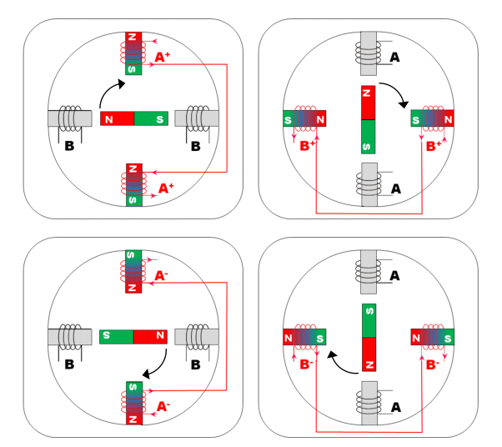
Operation of Stepper Motor
Stepper motor contains Permanent Magnet (rotor) and electromagnet Stator, with one-phase-on configuration.
In the top left figure, North pole of rotor is attracted by South pole of A+ electromagnet. South pole of rotor is attracted by North pole of A+ electromagnet.
A and B are stator poles.
Image Courtesy: Faulhaber Brochure [1]

Slide 10
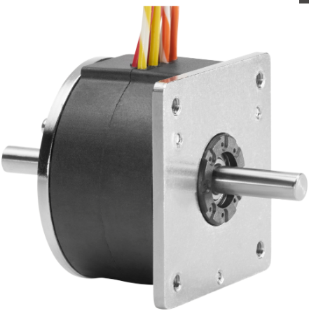
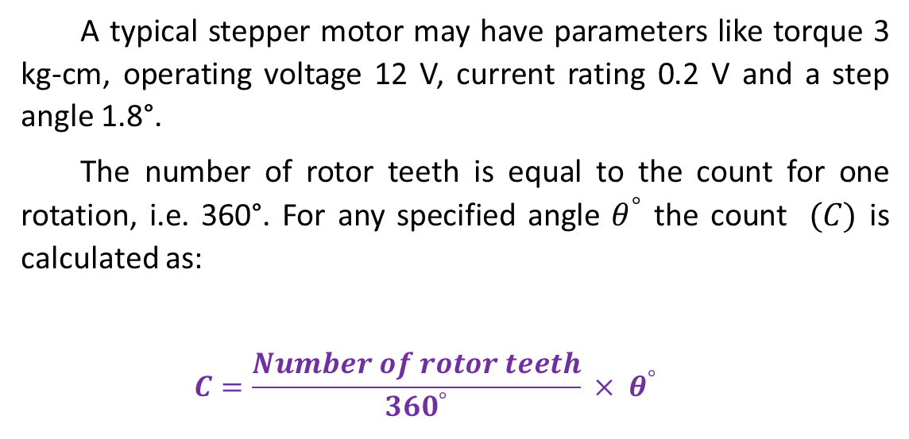
Typical Stepper Motor
A typical stepper motor may have parameters like torque 3 kg-cm, operating voltage 12 V, current rating 0.2 V and a step angle 1.8°.
The number of rotor teeth is equal to the count for one rotation, i.e. 360°. For any specified angle $θ^{°}$ the count $(C)$ is calculated as:
$$C=\frac{Number of rotor teeth}{{360}^{°}} × θ^{°}$$
Image Courtesy: Faulhaber
Reference
[1]_https://www.faulhaber.com/fileadmin/user_upload_global/support/MC_Support/Motors/AppNotes/Faulhaber_AN001_EN.pdf ~ Interesting and well written article

Slide 11
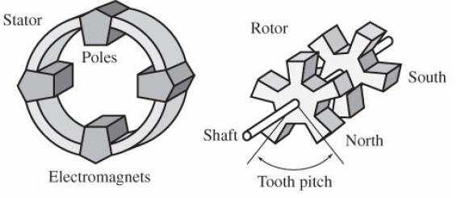
From Other Source (1/5)
Rotors invariably made up of permanent magnet
Image Courtesy: Mrs. Suganthi Brindha G., In turn Google

Slide 12
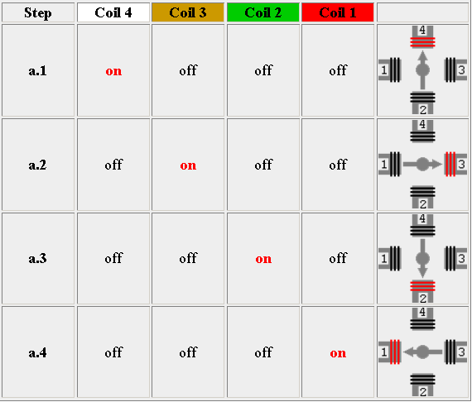
From Other Source (2/5)
Single Coil Excitation.
Excited coil is shown in red colour
Image Courtesy: Mrs. Suganthi Brindha G., In turn Google

Slide 13
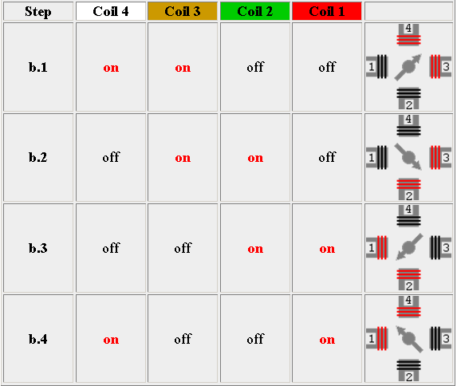
From Other Source (3/5)
TWO Coil Excitation.
Each successive pair of adjacent coils is energized in turn.
Image Courtesy: Mrs. Suganthi Brindha G., In turn Google

Slide 14
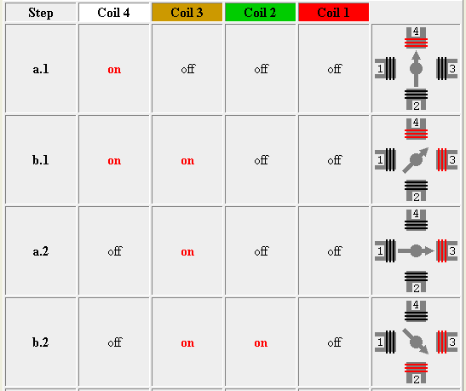
From Other Source (4/5)
HALF Step Sequence.
2 sequences interleaved.
normal (4 step) + wave drive (4 step) Total 8 steps.
Image Courtesy: Mrs. Suganthi Brindha G., In turn Google

Slide 15
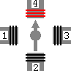
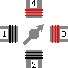
From Other Source (5/5)
Interleaved Single- and
Two-Coil Excitation
Half-Stepping
Single-Coil Excitation
Two-Coil Excitation

Slide 16
S – 7 Programmable Interval Timer 8254 & Interfacing 8254 with 8086 and programming

Slide 17
Features of 8254
Three Independent 16-Bit Counters,
Clock input up to 10 MHz,
Status Read-Back Command,
Six Programmable Counter Modes,
Binary or BCD Counting,
Single +5V Supply,
Superset of PIT-8253.

Slide 18
Pin Diagram

Slide 19
Pin Description

Slide 20
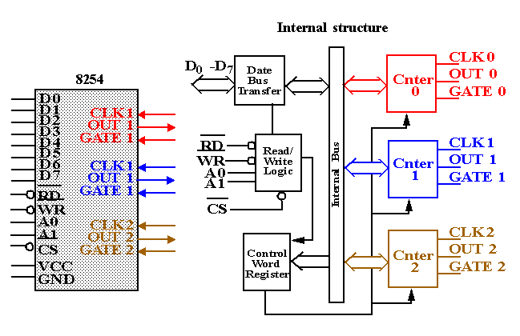
Block Diagram of 8254

Slide 21
Internal Blocks of Counter
Count Register (CR) to store count (CRL & CRM),
Counting elements (CE) are used for counting,
Output Latch (OLL & OLM) to latch the count in CE,
The Control Word Register is not part of the Counter itself, but its contents determine how the Counter operates.
The status register, when latched, contains the current contents of the Control Word Register and status of the output and null count flag.

Slide 22
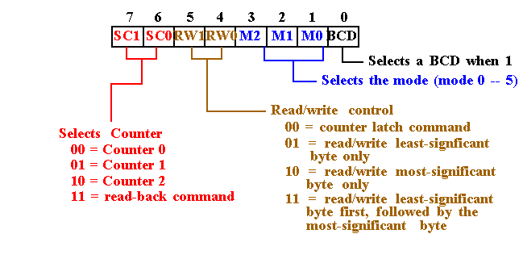
Control Word format
8254 Programming
Each counter is individually programmed by writing a control word, followed by the initial count.
The control word allows the programmer to select the counter, mode of operation, binary or BCD count and type of operation (read/write).

Slide 23
Interleaved Read and Write Operations
Valid sequence for read and write of the same
counter set for two byte count:
Read least significant byte,
Write new least significant byte,
Read most significant byte,
Write new most significant byte.

Slide 24
6 Modes of 8254
Mode 0: Interrupt On Terminal Count
Mode 1: Hardware Retriggerable One-shot
Mode 2: Rate Generator
Mode 3: Square Wave Mode
Mode 4: Software Triggered Strobe
Mode 5: Hardware Triggered Strobe (Retriggerable)

Slide 25
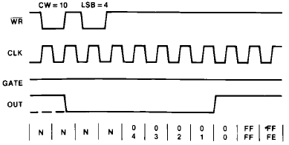
MODE 0 – Interrupt on Terminal Count
N : Undefined Count

Slide 26
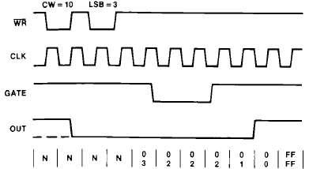
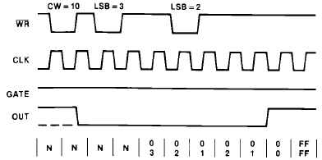
MODE 0 contd…

Slide 27
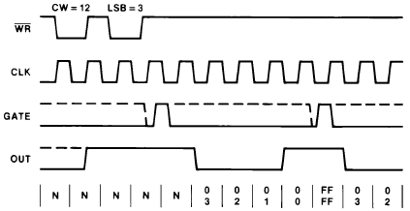
MODE 1: Hardware Retriggerable One Shot.

Slide 28
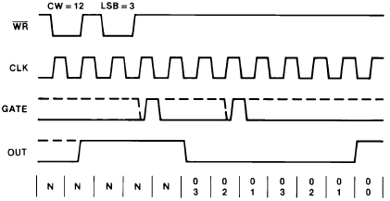
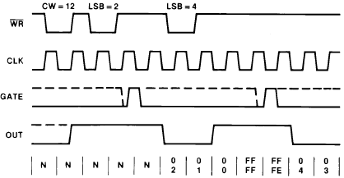
MODE 1 contd…

Slide 29
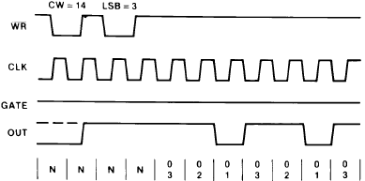
MODE 2: Rate Generator

Slide 30
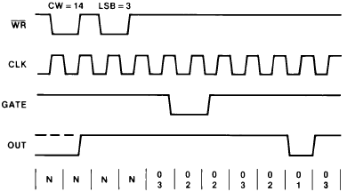
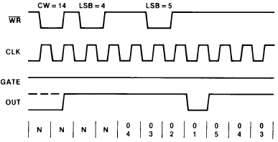
MODE 2 contd…

Slide 31
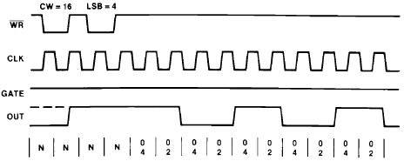
MODE 3: Square Wave Mode

Slide 32
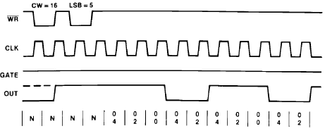
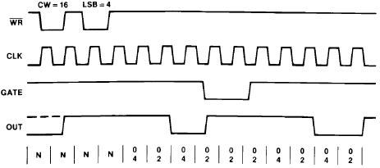
MODE 3 contd…

Slide 33
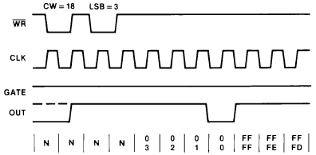
MODE 4: Software Triggered Strobe

Slide 34
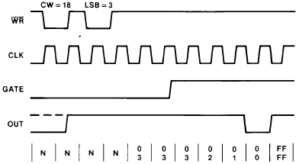
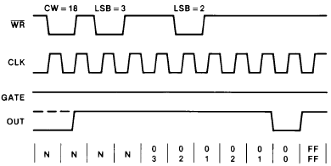
MODE 4 contd…

Slide 35
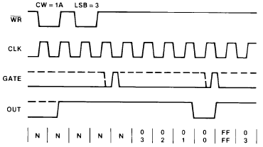
MODE 5 : Hardware Triggered Strobe

Slide 36
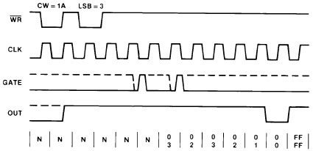
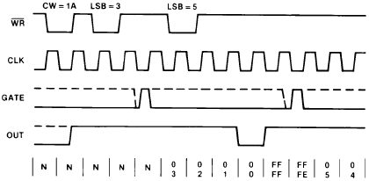
MODE 5 contd…

Slide 37
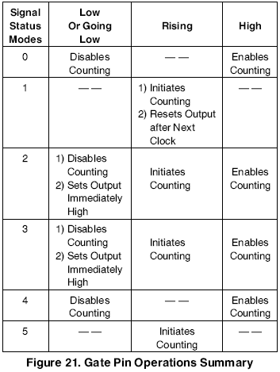
8254 contd…

Slide 38
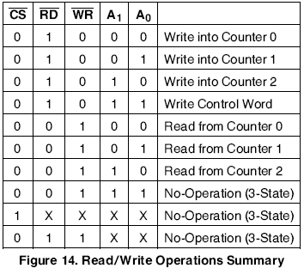
8254 contd…

Slide 39
Minimum & Maximum Initial Count

Slide 40
Gate Pin Operations Summary

Slide 41
Applications of 8254
Real time clock
Event-counter
Digital one-shot
Programmable rate generator
Square wave generator
Binary rate multiplier
Complex waveform generator
Complex motor controller

Slide 42
S – 8 Programmable Interrupt Controller 8259 & Interfacing 8259 with 8086 and programming

Slide 43
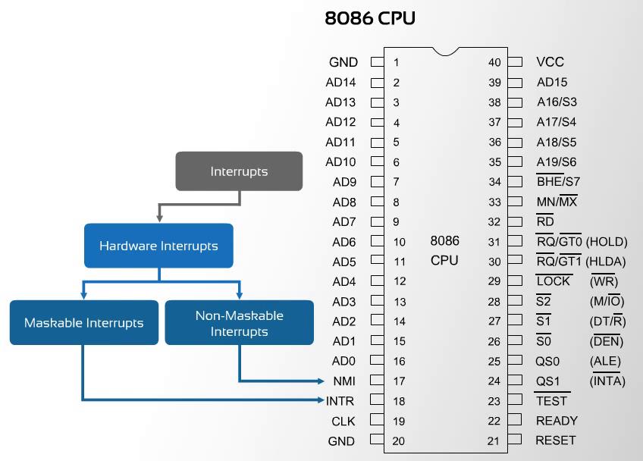
Programmable Interrupt Controller 8259
Image Courtesy: Google

Slide 44
8259 Programmable Interrupt Controller (PIC)
This IC is designed to simplify the implementation of the interrupt interface in the 8088 and 8086 based microcomputer systems.
This device is known as a ‘Programmable Interrupt Controller’ or PIC.
It is manufactured using the NMOS technology and It is available in 28-pin DIP.
The operation of the PIC is programmable under software control (Programmable)and it can be configured for a wide variety of applications.
8259A is treated as peripheral in a microcomputer system.
8259A PIC adds eight vectored priority encoded interrupts to the microprocessor.

Slide 45
8259 Programmable Interrupt Controller (PIC) (2)
This controller can be expanded without additional hardware to accept up to 64 interrupt request inputs. This expansion required a master 8259A and eight 8259A slaves.
Some of its programmable features are:
The ability to accept level-triggered or edge-triggered inputs.
The ability to be easily cascaded to expand from 8 to 64 interrupt-inputs.
Its ability to be configured to implement a wide variety of priority schemes.

Slide 46
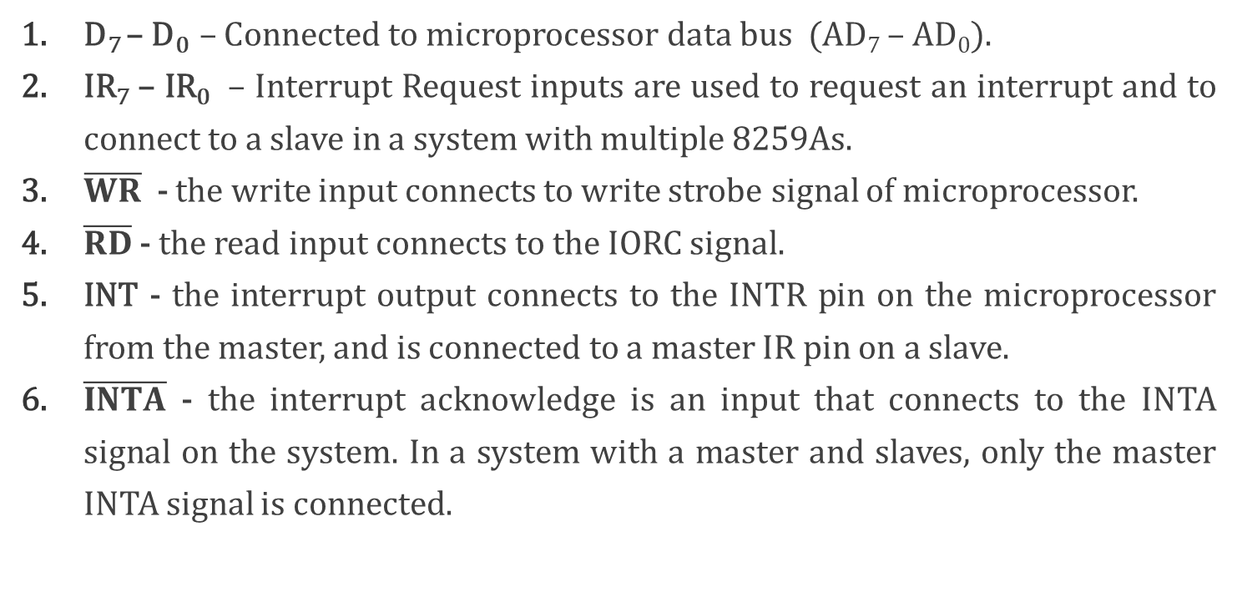
Assignment of Signals for 8259
D₇ – D₀ – Connected to microprocessor data bus (AD₇ – AD₀).
IR₇ – IR₀ – Interrupt Request inputs are used to request an interrupt and to connect to a slave in a system with multiple 8259As.
$\overline{WR}$ - the write input connects to write strobe signal of microprocessor.
$\overline{RD}$ - the read input connects to the IORC signal.
INT - the interrupt output connects to the INTR pin on the microprocessor from the master, and is connected to a master IR pin on a slave.
$\overline{INTA}$ - the interrupt acknowledge is an input that connects to the INTA signal on the system. In a system with a master and slaves, only the master INTA signal is connected.

Slide 47
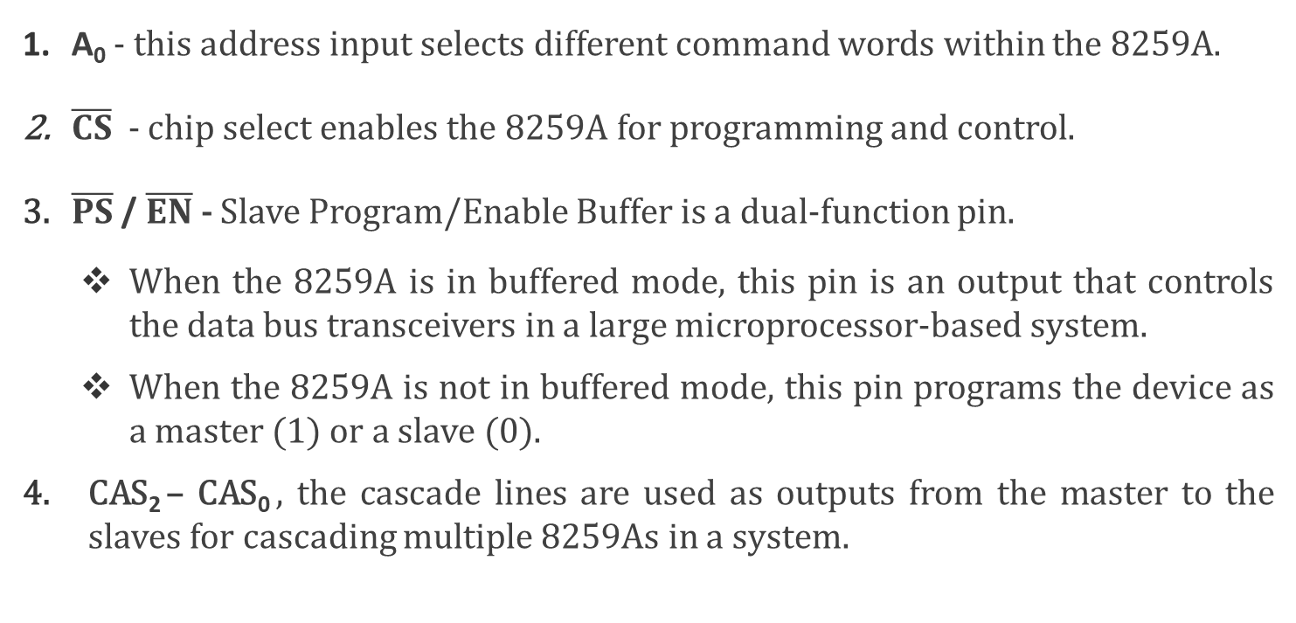
Assignment of Signals for 8259 (2)
A₀ - this address input selects different command words within the 8259A.
$\overline{CS}$ - chip select enables the 8259A for programming and control.
$\overline{PS}$ / $\overline{EN}$ - Slave Program/Enable Buffer is a dual-function pin.
When the 8259A is in buffered mode, this pin is an output that controls the data bus transceivers in a large microprocessor-based system.
When the 8259A is not in buffered mode, this pin programs the device as a master (1) or a slave (0).
CAS₂ – CAS₀ , the cascade lines are used as outputs from the master to the slaves for cascading multiple 8259As in a system.

Slide 48
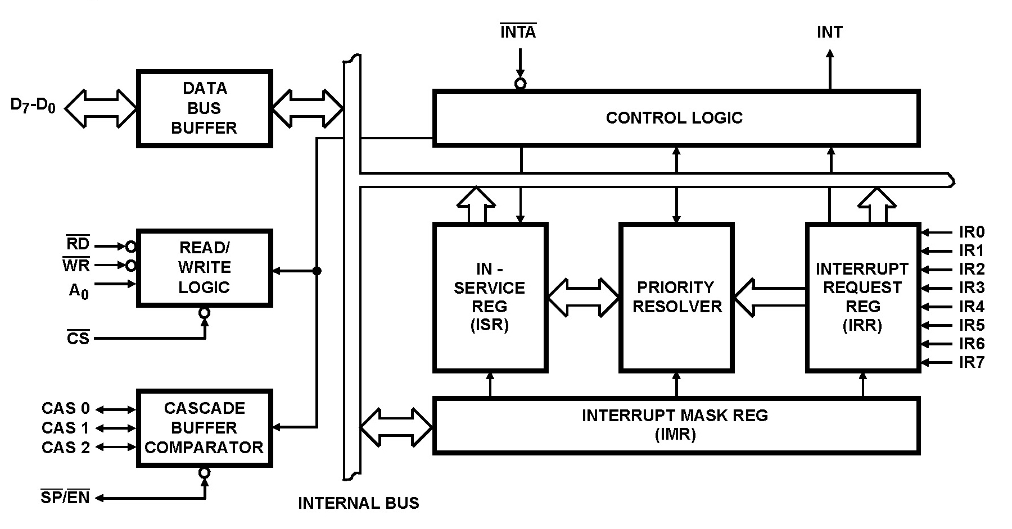
8259A PIC- Block Diagram
Image Courtesy: Google

Slide 49
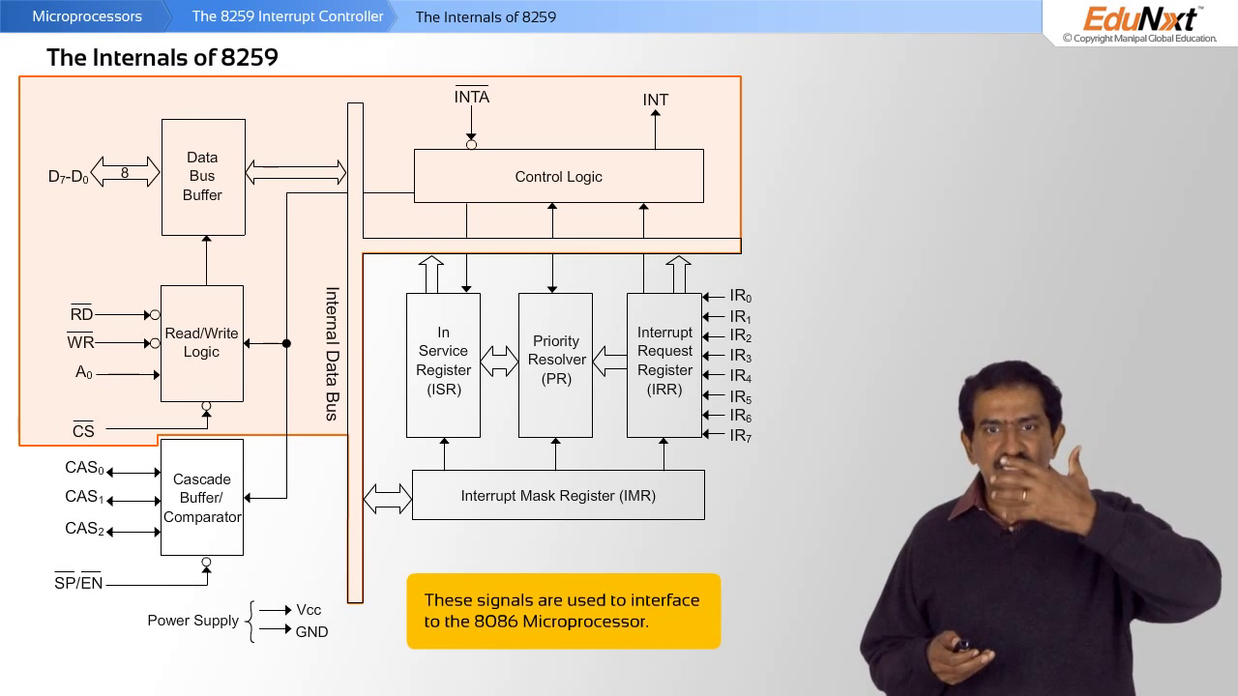
8259A - Internals (1/4)
Image Courtesy: Google

Slide 50
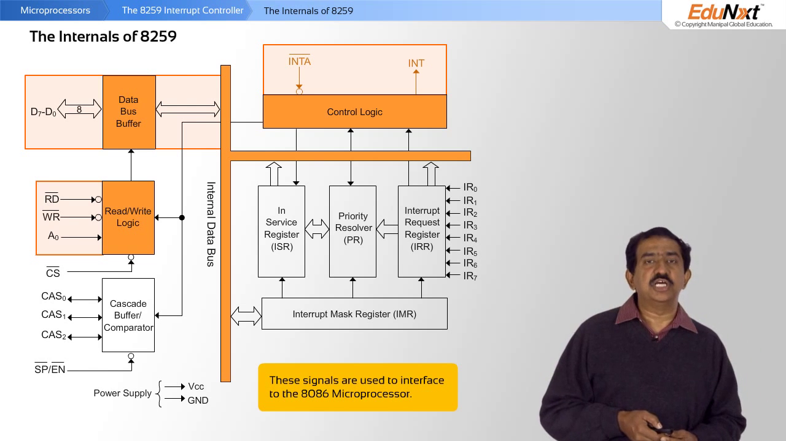
8259A - Internals (2/4)
Image Courtesy: Google

Slide 51
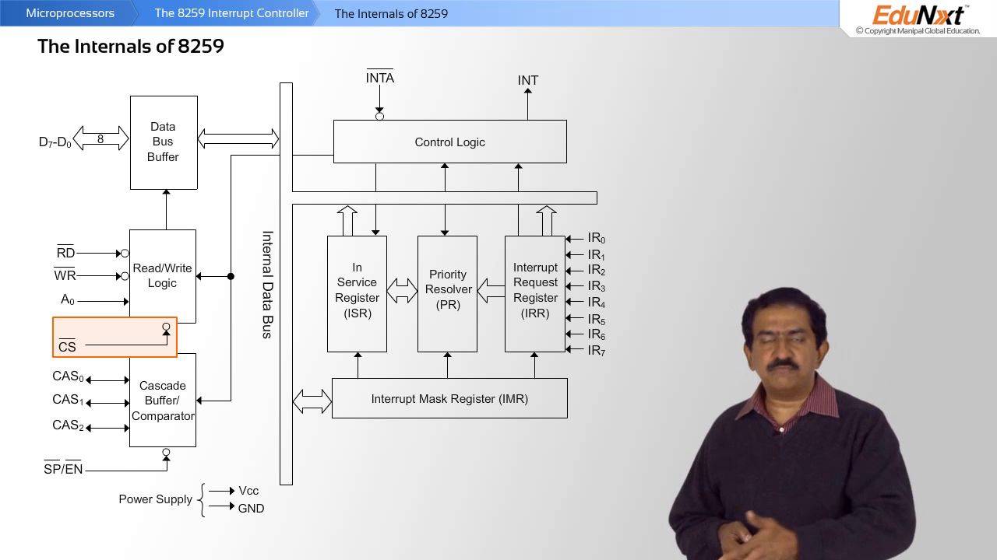
8259A - Internals (3/4)
Image Courtesy: Google

Slide 52
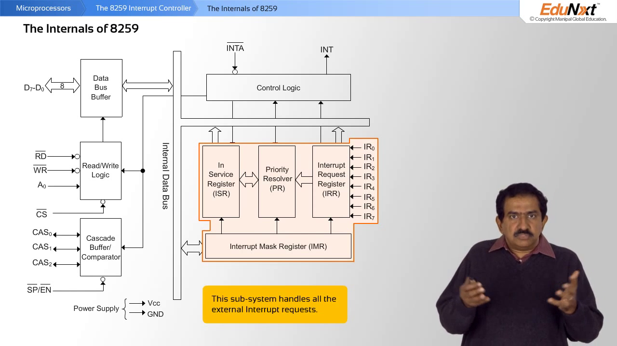
8259A - Internals (4/4)
Image Courtesy: Google

Slide 53
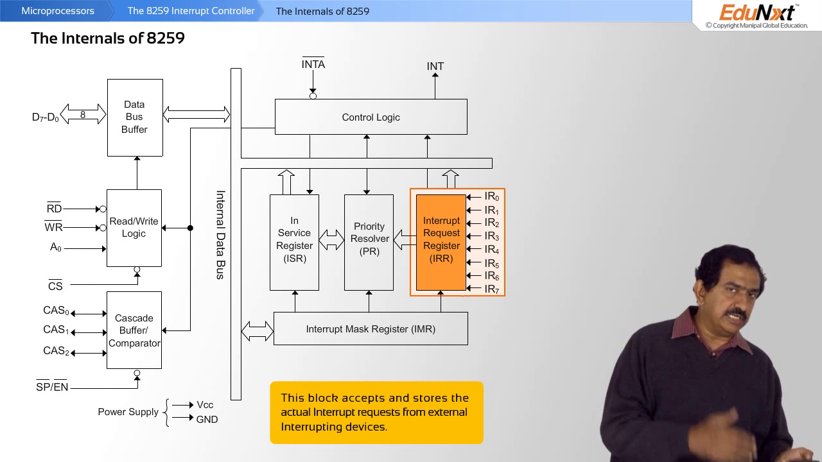
8259A - Internals (IPR)
Image Courtesy: Google

Slide 54
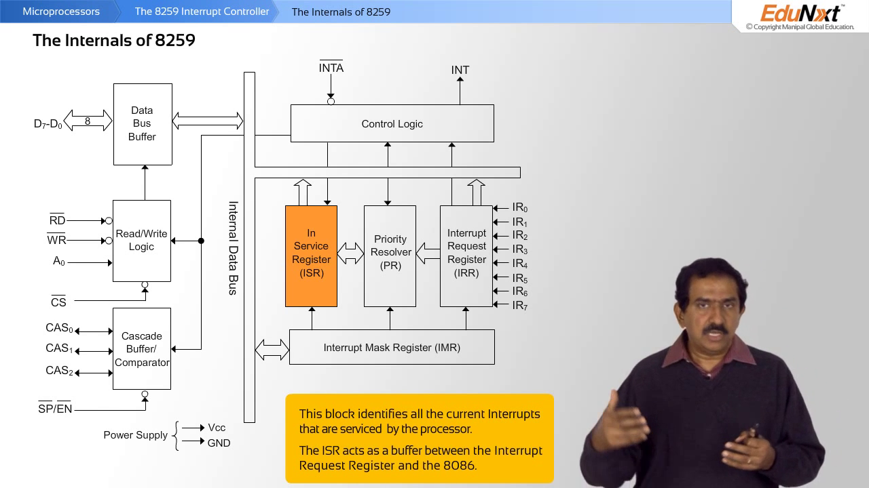
8259A - Internals (ISR)
Image Courtesy: Google

Slide 55
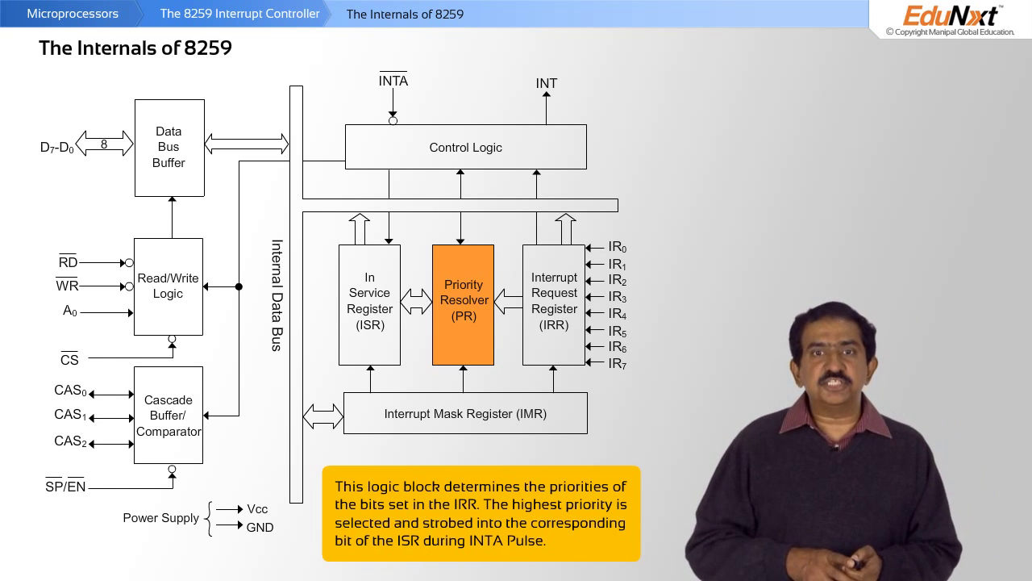
8259A - Internals (PR)
Image Courtesy: Google

Slide 56
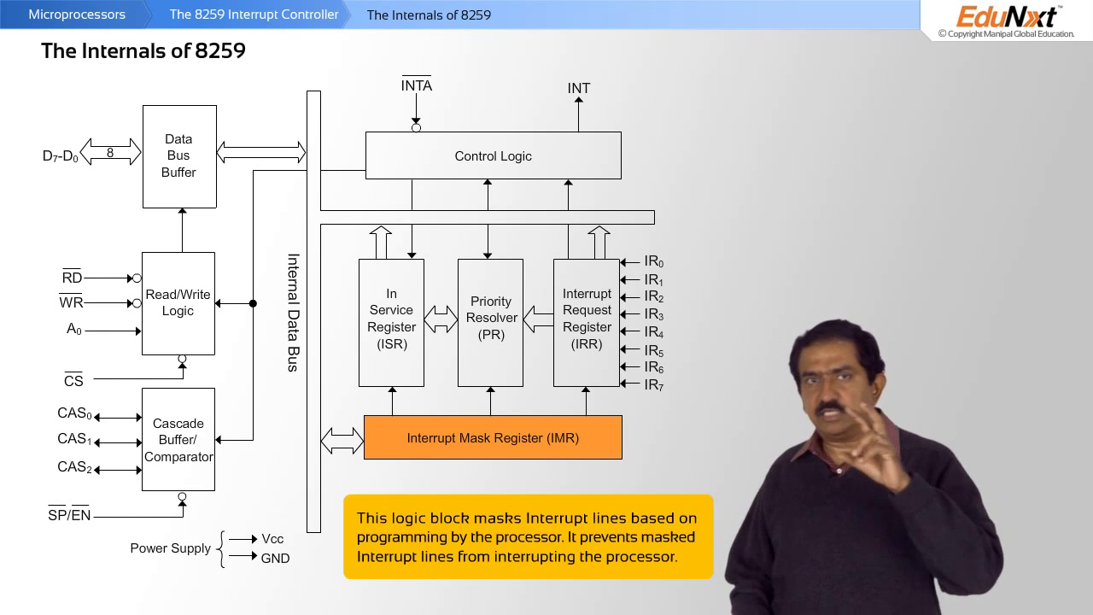
8259A - Internals (IMR)
Image Courtesy: Google

Slide 57
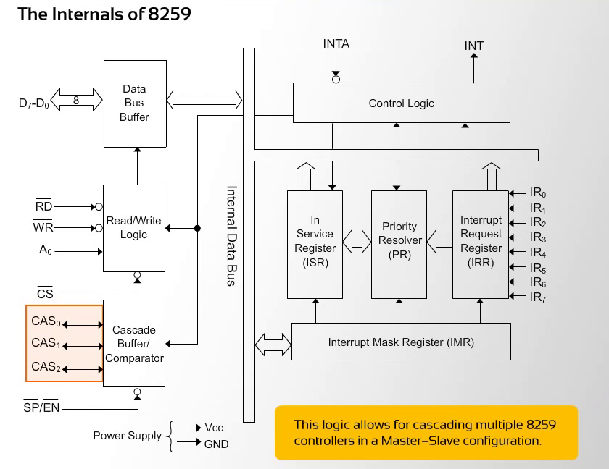
8259A - Internals (CAS)
Image Courtesy: Google

Slide 58
Cascading multiple 8259
External e device 00
IR0
……..…
……..…
……..…
INT
IR7
Microprocessor
External e device 07
Slave 8259A
Interrupt controller
Master 8259A
Interrupt controller
INT
IR0
…………………
INTR
IR7
INT
Connecting Multiple (64) interrupted I/O devices to processor
Slave 8259A
Interrupt controller
External e device 53
IR0
……..…
……..…
INT
External e device 64
IR7
Image Courtesy: Google

Slide 59
Learning Resource
[1] K. M. Bhurchandi and A. K. Ray, “Advanced Microprocessors and Peripherals – with ARM and an Introduction to Microcontrollers and Interfacing”, Tata McGraw Hill, 3rd ed., 2015.
Note: Almost all figures and text content taken from the above stated book.

Slide 60
Thank You

